Slide 1



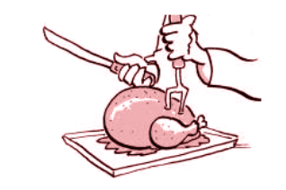

DamGate: Dynamic Adaptive Multi-feature Gating in Program Binaries
Yurong Chen, Tian Lan, Guru Venkataramani
ACM CCS FEAST 2017

Slide 2
De-bloat: Make software “slimmer” by removing unused features
Guoqing Xu, Nick Mitchell, Matthew Arnold, Atanas Rountev, and Gary Sevitsky. "Software bloat analysis: finding, removing, and preventing performance problems in modern large-scale object-oriented applications."
Guoqing Xu, Nick Mitchell, Matthew Arnold, Atanas Rountev, Edith Schonberg, and Gary Sevitsky. "Scalable runtime bloat detection using abstract dynamic slicing."
Yufei Jiang, Dinghao Wu, and Peng Liu. "JRed: Program Customization and Bloatware Mitigation Based on Static Analysis."
Yufei Jiang, Can Zhang, Dinghao Wu, and Peng Liu. "Feature-Based Software Customization: Preliminary Analysis, Formalization, and Methods.”
Static:
Remove unused code
Dynamic:
Remove inefficient runtime behavior

Slide 3

What’s more?
Undesired interactions among different features
Varying user requirements

Slide 4
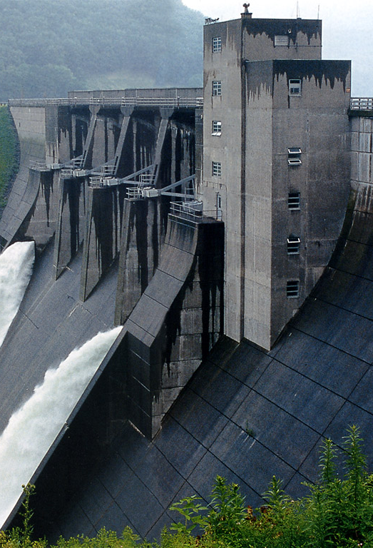
Goal of Design
Ideas
Be compatible with de-bloating
Customize binaries after de-bloating
Prevent undesired interactions among features
Instrument binary to add checker functions
Enable dynamic reconfiguration of feature profile
Multiple features are kept in binaries and managed by config file
DamGate

Slide 5
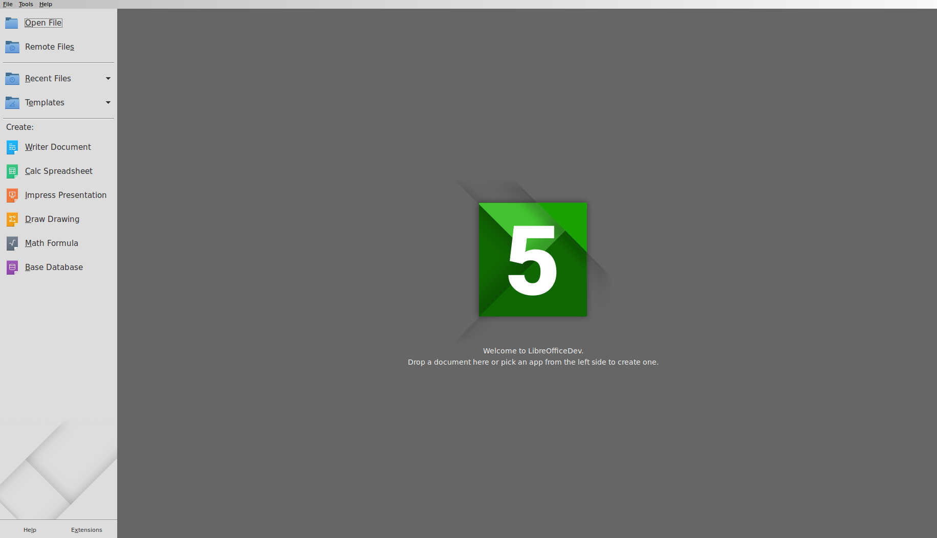
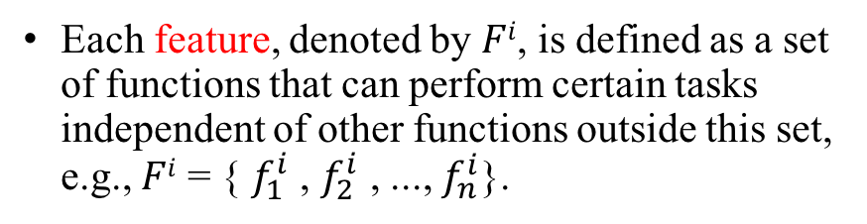
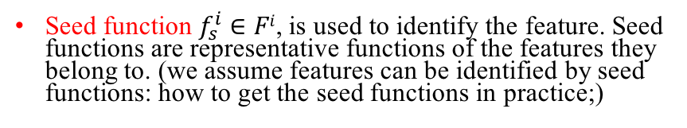
Definitions
Each feature, denoted by $Fi$, is defined as a set of functions that can perform certain tasks independent of other functions outside this set, e.g., $Fi$ = { $f_{1}^{i}$ , $f_{2}^{i}$ , ..., $f_{n}^{i}$}.
Seed function $f_{s}^{i}$ $∈$ $Fi$, is used to identify the feature. Seed functions are representative functions of the features they belong to. (we assume features can be identified by seed functions: how to get the seed functions in practice;)
Feature Name | Seed Function
Save file | SfxObjectShell::SaveTo_Impl
Print | SfxViewShell::ExecPrint
Insert image | SwView::InsertGraphic
Gate: a function checker that verify if the target function is allowed according to current protection policy.
Examples
(from Libre-office)

Slide 6
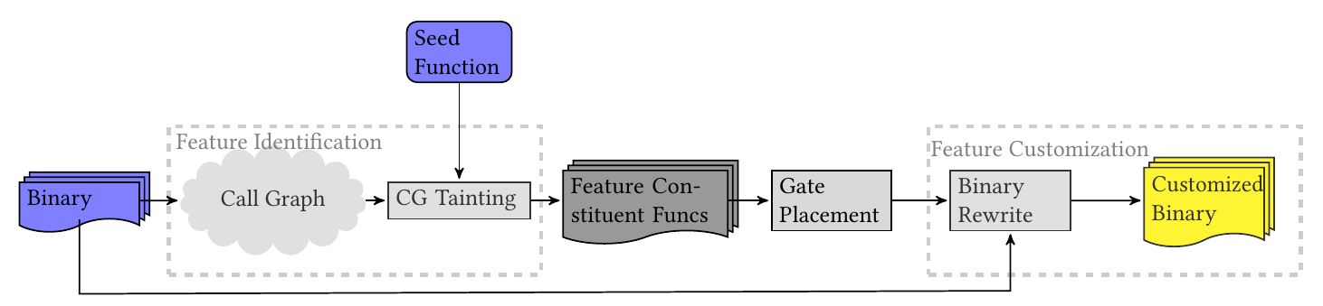
System Overview

Slide 7
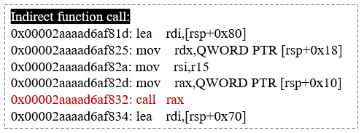
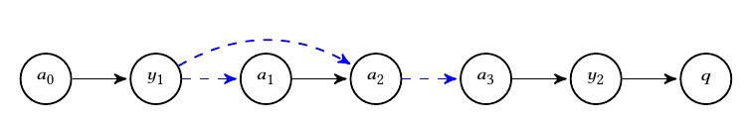
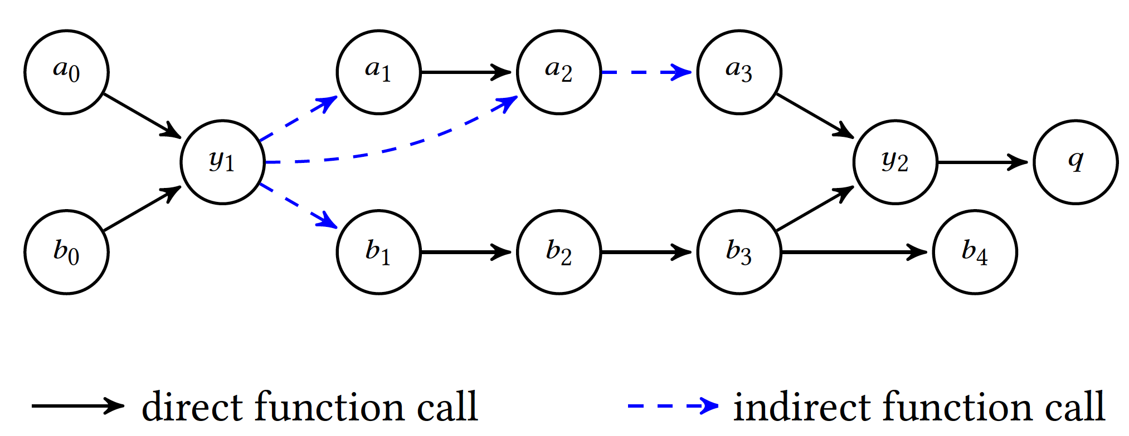
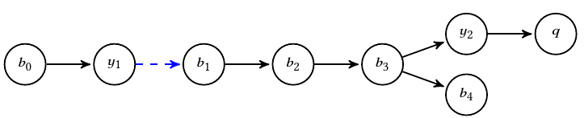
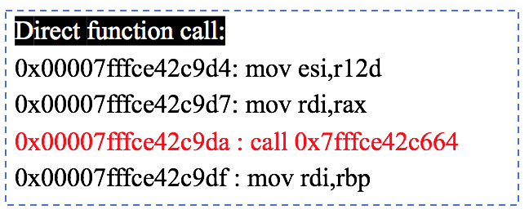
Example: LibreOffice
Feature a
a1: 0x00007ffff5087584
a2: 0x00007ffff507c44e
a3: 0x00007ffff589a837
b1: 0x00007fffce42c97e
b2: 0x00007fffce42c9da
b3: 0x00007fffce42c8bf
b4: 0x00007fffcdc52fe2
y1: 0x00007ffff4ef78d8
y2: 0x00007fffcdab3994
q: 0x00007fffcda8fff0
Feature b

Slide 8
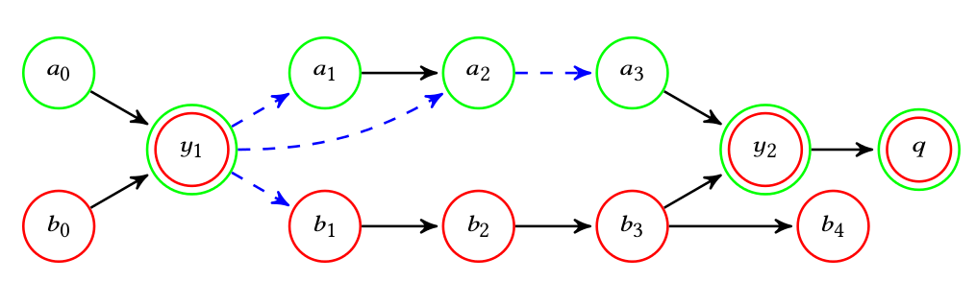
Example

Slide 9
Feature Identification
Call Graph (CG) generation from binary:
Static tool: CodeSurfer (from GrammaTech)
Dynamic tool: Pin (from Intel)
CG Tainting: CG + seed functions
Mark function calls as direct or indirect ones in the CG

Slide 10
Feature Customization
Direct Gate : check feature
Indirect Gate: check control transfer + feature
Martín Abadi, Mihai Budiu, Ulfar Erlingsson, and Jay Ligatti. "Control-flow integrity."
Chao Zhang, Tao Wei, Zhaofeng Chen, Lei Duan, Laszlo Szekeres, Stephen McCamant, Dawn Song, and Wei Zou. "Practical control flow integrity and randomization for binary executables.”
Ben Niu, and Gang Tan. "Modular control-flow integrity."
Binary rewriting: Dyninst (from University of Wisconsin-Madison and University of Maryland)

Slide 11
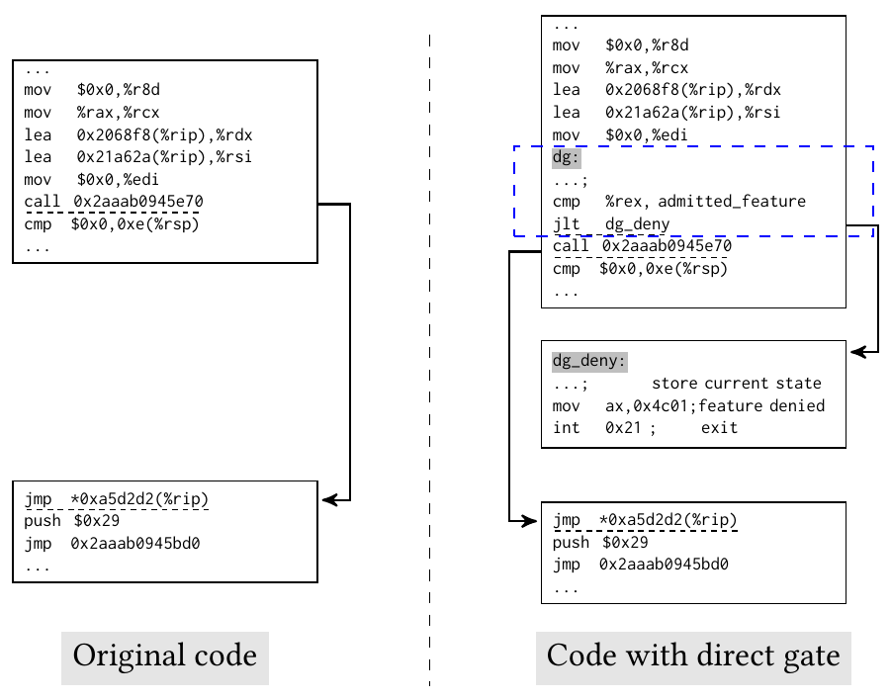

Feature Customization: Direct Gate
Direct Gate

Slide 12
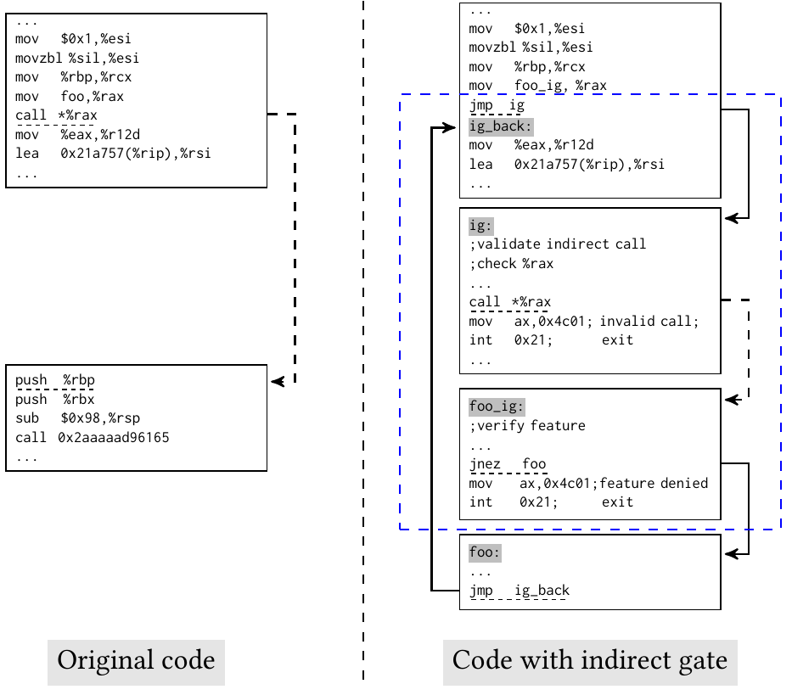
Feature Customization: Indirect Gate
Indirect Gate
1
Check integrity
2
Check feature
3
4
Call foo()

Slide 13


Slide 14
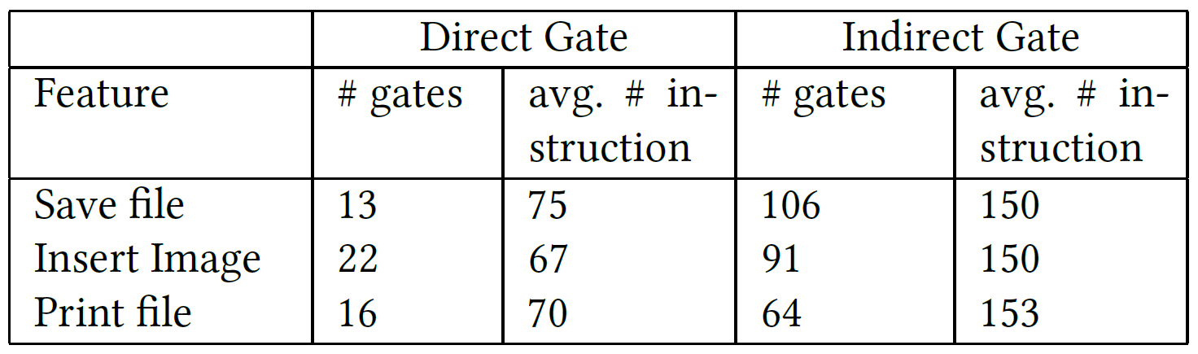
Evaluation
LibreOffice

Slide 15
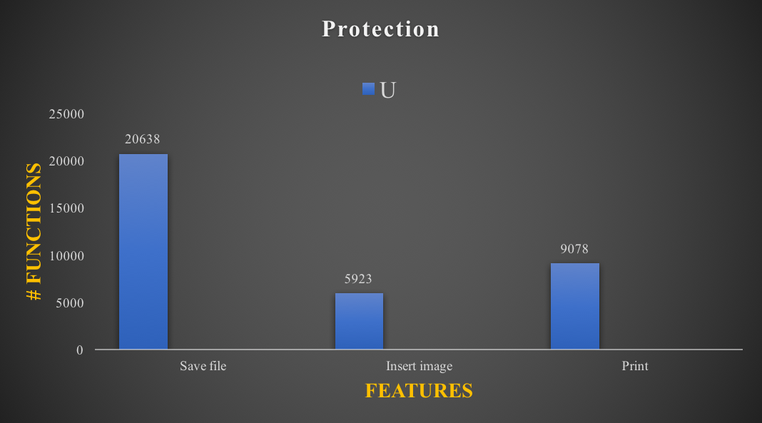
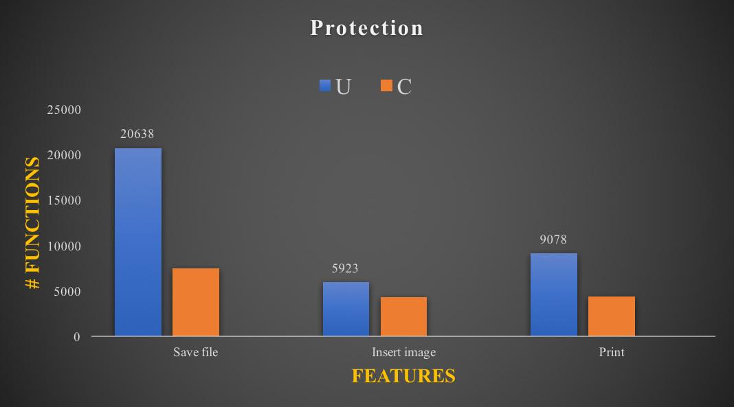
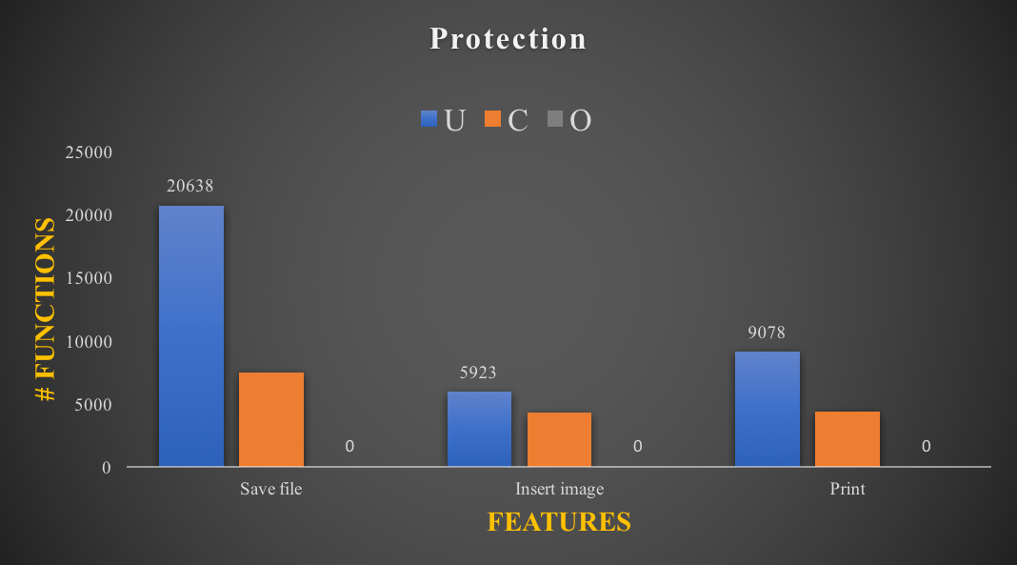
Evaluation
U: unique functions that only belong to current feature
C: common functions shared by current feature and other features
O: functions that don not belong to current feature but are still accessed
LibreOffice

Slide 16
Summary & Future work
Tools:
Feature identification: CodeSurfer, Pin
Feature customization: Dyninst
Gating policy;
Open source, automated framework

Slide 17
Thank you!
N00014-17-1-2786 & N00014-15-1-2210

